Slide 1
Multiple Linear Regression Model using R
Name: Abhishek K Singh

Slide 2
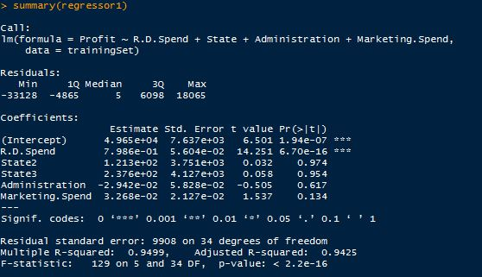
Polynomial Regression Output Considering All Independent variables
Conclusion: We can clearly observe from above model output that
Pr = 0.974 & 0.954 >> 0.05, therefore State variable is not significant to “Profit”
So, we can ignore “State1” & “State2”, from our model

Slide 3
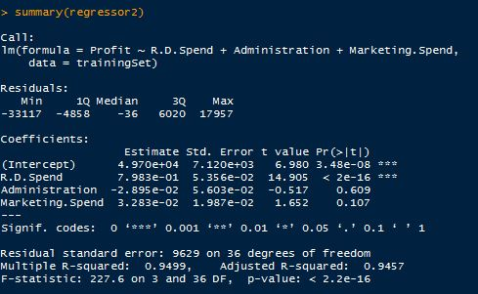
Polynomial Regression Output Removing “State” Variable
Conclusion: We can clearly observe from above model output that
Pr = 0.609 >> 0.05, therefore “Administration” variable is not significant to “Profit”
So, we can ignore “Administration” variable from our model

Slide 4
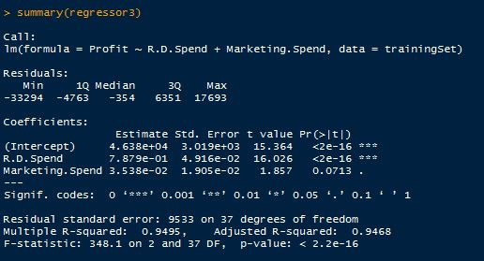
Polynomial Regression Output Removing “Administration” Variable
Conclusion: We can clearly observe from above model output that
Pr = 0.07 ≈ 0.05, therefore “Marketing.Spend” variable is may or may not be
significant to “Profit”
So, lets see what happens if we ignore “Marketing.Spend” variable from our model

Slide 5
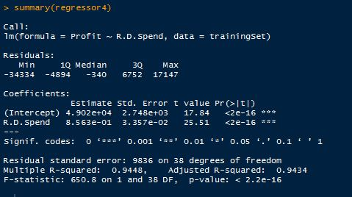
Polynomial Regression Output Removing “Marketing.Spend” Variable
Conclusion: We can clearly observe from above model output that
“Adjusted R-squared” decreased from “0.9468” in the previous model to “0.9434” in this model & “Adjusted R-squared” should be close to 1 for Modeling Parameters to have stronger relationship
So, 3rd model was better than 4th model

Slide 6
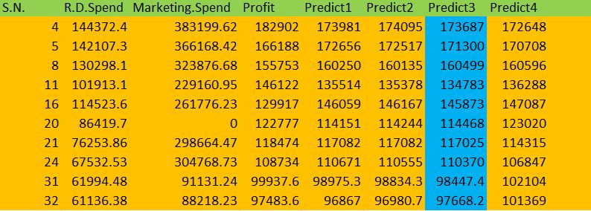
Prediction Comparison of different model on Test data
Conclusion: We can clearly observe from the above prediction output that
“Predict3” is Closest prediction to our actual prediction
So, Regression Model 3 is best model for this dataset

